Slide 1

Energy system modelling using OSeMOSYS
LECTURE 14
MODEL CALIBRATION AND QUALITY ASSURANCE

Slide 2
Learning Outcomes
By the end of this lecture, you will be able to:
ILO1: Understand the concept of model calibration.
ILO2: Learn the basic steps and parameters used to calibrate an OSeMOSYS model.
ILO3: Identify additional parameters necessary for an accurate representation of an energy system.
2

Slide 3

14.1 Introducing Model Calibration
14.1.1 What is model calibration about?
Model calibration refers to the process of adjusting model parameters to ensure that outputs align with historical real-world data. The main thing to ensure is that you have at least calibrated the base year (first year in the model).
Notes:
Model calibration involves adjusting parameters to ensure that the model's outputs align with historical real-world data. In the case of OSeMOSYS, an optimization-based mathematical model, the goal is to produce an optimal solution rather than the most probable one. Calibration, in this context, focuses on replicating historical and realistic energy production and consumption patterns throughout the timeline. There are several aspects of the model that you can calibrate but the main one is ensuring the first year of your model matches the energy balance of that country for that year. You could alternatively calibrate the emissions of the model.
However, we typically calibrate energy production and capacity while conducting a sense-check on emissions, rather than primarily calibrating emissions. This is because emissions are a direct consequence of energy production and use, properly calibrating energy production and consumption should result in aligned emission levels. This is because fossil fuel combustion—and its associated emissions—is directly proportional to energy use.

Slide 4
14.1 Introducing Model Calibration
14.1.2 What are you calibrating to?
The main thing that modellers typically calibrate to is the input fuel use of each sub-sector.
However, you can also calibrate the output product of sectors if you have the data.
For example, if you have the amount of steel or aluminium produced as well as the fuel used in these sub-sectors you can calibrate the model for both.
Another potential thing to calibrate to is the emissions of each sub-sector. This is typically done by calculating an implied emissions intensity using annual total activity and total emissions data.
However, calibrating fuel use AND emissions can result in some problems….
Notes:
This slide elaborates on the concept of model calibration. Calibration typically involves aligning the model's behaviour with known historical data. Most commonly, this means adjusting the model so that input fuel use in each sub-sector matches historical records. However, calibration can also be applied to sub-sector outputs—such as the tons of steel or aluminium produced—if that data is available for the relevant years.
In many cases, particularly in the industry and transport sectors, the model can be calibrated using both input fuel use and output activity data to improve overall accuracy.
Additionally, calibration can include emissions data. In this approach, the model is aligned to match both fuel use and emissions by calculating an implied emissions intensity—that is, the amount of emissions released per unit of activity. To do this, you'll need annual data for both total activity and total emissions for the sector or area being modelled.
However, it's important to be cautious when calibrating to both fuel use and emissions. Consider a scenario where a country has underreported coal use, but a separate agency has overreported emissions from coal. This would result in an unrealistically high emissions intensity for coal. While this inconsistency might be acceptable if the goal is to preserve both the energy and emissions balances, it highlights the importance of cross-checking data sources.
Best practice is to first perform a bottom-up calculation—multiplying fuel use by the relevant IPCC emissions factors—then compare those results with the national emissions inventory. Depending on the level of discrepancy, you can then adjust your approach accordingly.

Slide 5
Lecture 14.1 References
KTH. (2018). OSeMOSYS Documentation. https://osemosys.readthedocs.io/en/latest/index.html#
Plazas-Niño, F. (2024). Step-by-Step Guide to National Energy System Modelling with OSeMOSYS (v1.0). Zenodo. https://doi.org/10.5281/zenodo.13883416
5

Slide 6
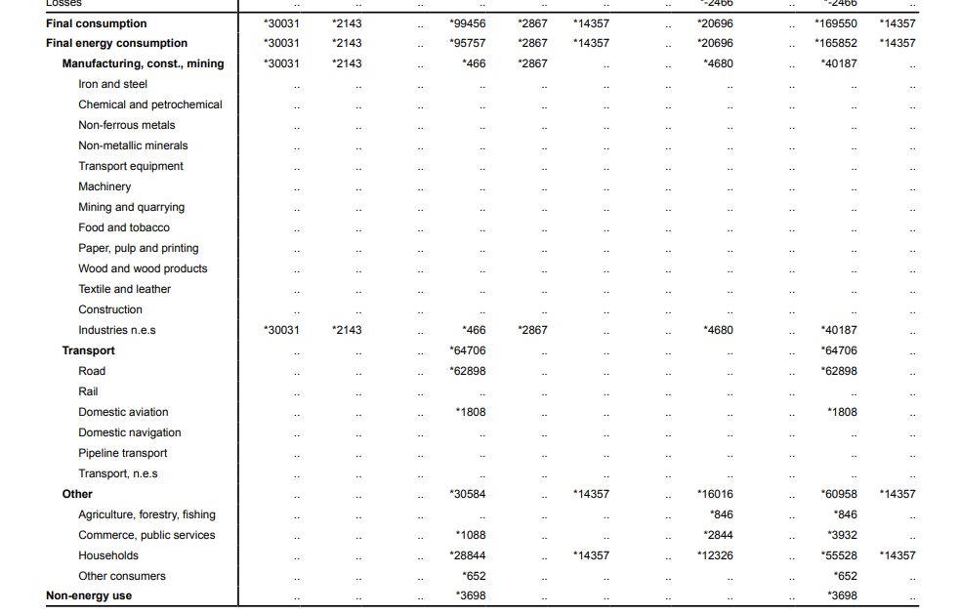
14.2 Using an Energy Balance
14.2.1 How to calibrate using the Energy Balance
An essential resource often needed to calibrate energy use is the country’s energy balance.
Notes:
The energy balance of a country is a comprehensive summary of all energy flows within its economy over a specific period, usually a year. It shows how energy is produced, imported, exported, transformed, and consumed across different sectors (e.g., industry, transport, households). The balance ensures that total energy inputs equal total outputs, accounting for losses and conversions—providing insights into energy dependency, efficiency, and sectoral demand.
Typically, you would need to find some energy balances to calibrate a model.

Slide 7

14.2 Using an Energy Balance
14.2.2 Calibrating the base year
Why is it important to calibrate the base year?
Ensures the model reflects real-world energy supply, demand, and performance.
Provides a reliable and realistic starting point using historical data.
Builds trust and credibility in the model’s results for stakeholders.
Improves accuracy of future energy projections and investment planning.
Identifies data gaps, errors, or inconsistencies early in the process.
Verifies technologies and system constraints function as expected in the model.
Notes:
Usually, we use the energy balance to calibrate the start year (base year) of the model.
There are several reasons for doing this. Calibrating your model:
Establishes a Realistic Starting Point
The base year represents the most recent year with reliable data. Calibration ensures the model reflects actual historical energy supply, demand, and system performance. Without a good match to reality, future projections will be unreliable.
2. Builds Trust in the Model Calibration shows that the model can reproduce known outcomes. This increases confidence among stakeholders, especially decision-makers using the model for energy planning or policy development.
3. Improves Accuracy of Projections A well-calibrated model minimizes errors in cost assumptions, efficiencies, and capacities. This leads to more accurate simulations of future energy scenarios, emissions, and investment needs.
4. Helps Identify and Fix Data Issues The calibration process may reveal gaps, inconsistencies, or errors in input data. Catching these issues early ensures better quality throughout the modelling process.
5. Ensures Proper Functioning of Technologies and Constraints Calibration verifies that all modelled technologies operate as expected under real-world conditions. It also confirms that constraints such as capacity limits and fuel availability are set realistically.

Slide 8
14.2 Using an Energy Balance
14.2.3 Example for Calibrating Using the Energy Balance
1. Convert to PJ: 1088 TJ/ 1000 = 1.088 PJ 2. Account for efficiency of technology: 1.088/1.266 = 0.859 PJ 3. Force this fuel use for the technology using lower and upper limits
Notes:
Above is an example of how you would calibrate your model using an energy balance. In this example we are trying to calibrate the activity of an oil boiler for services heating. Using the energy balance, we note that the commercial and public services sector uses 1088 terajoules of oil. Let’s say the only technology using oil in the commercial sector are oil boilers. To calibrate the oil boiler to match the energy balance value in your base year (2021) you would first convert the energy balance value into petajoules since this is the unit we work with in OSeMOSYS. Next, you would divide this value by the efficiency (i.e. input activity ratio) of your services oil boiler technology to account for losses during the transformation of oil to heat. Lastly, you would force this calculated value in your model using a parameter called ‘Total Technology Annual Activity Lower Limit’. This parameter/constraint tells the model a clear lower restriction on the overall operation of a particular technology. It establishes a lower limit on the total activity within a year. Then, you want to set an upper bound, which would be 1% more than the lower limit value. This 1% is applied to give the model some wiggle room to avoid any issues when running the model. This upper bound is then applied to the ‘Total Technology Annual Activity Upper Limit’ parameter for the services oil boiler technology. This parameter tells the model there is a clear maximum restriction on the overall operation of a particular technology. It establishes an upper limit on the total activity within a year. Using these constraints forces the model to use the right amount of fuel for each technology in each sub-sector for the base year.

Slide 9
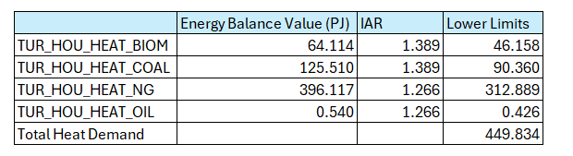
14.2 Using an Energy Balance
14.2.4 Calculating Demand Using the Energy Balance
As described in the previous slide lower limits are calculated by dividing the energy balance values by the input activity ratios of the respective technologies.
The total housing heating demand for this year is then calculated by summing the lower limits of all the technologies.
Demand for HOU_HEAT = 46.158 + 90.360 + 312.889 + 0.426 = 449.834 PJ
Notes:
If demand is not available through other sources, then it can be calculated using the calibrated lower limit values. Once you have calculated the calibrated lower limits for the relevant technologies that provide a particular service you can simply sum the lower limits to get the demand for that service. This is only one method to calculate the demand. Demands can also be taken from government reports, international databases etc.

Slide 10
Lecture 14.2 References
KTH. (2018). OSeMOSYS Documentation. https://osemosys.readthedocs.io/en/latest/index.html#
Plazas-Niño, F. (2024). Step-by-Step Guide to National Energy System Modelling with OSeMOSYS (v1.0). Zenodo. https://doi.org/10.5281/zenodo.13883416
10

Slide 11
14.3 Basics in Model Calibration
14.3.1 Residual capacity
The existing installed capacity of a technology in the base year or historical years. It represents infrastructure that is already in place and available for use, without needing new investment.
Residual Capacity
There are two main categories of residual capacity:
Known vintage dates – this mainly applies to the power sector and occasionally large industrial facilities. It is based on actual data that you calculate a residual capacity profile for.
Unknown vintage dates – for everything else you would use model outputs to determine the residual capacity.
11
Notes:
Residual Capacity refers to the existing installed capacity of a technology at the start of the model's time horizon, typically for the base year or historical years. It represents infrastructure that is already in place and available for use, without requiring new investment. In OSeMOSYS, this capacity is gradually declined in future years to reflect retirement or decommissioning of aging infrastructure. This gradual reduction ensures the model accurately captures the limited operational lifespan of existing assets and avoids overestimating available capacity in long-term projections. There are two main categories of residual capacity:
1. Known vintage dates: This applies mainly to the power sector (occasionally to large industrial facilities too). Based on actual data on commission dates, decommission dates, and operational lives you can calculate the residual capacity profile (capacity declining over time). For example, in the power sector, where individual power plants can be identified and decommissioning schedules are often available, estimating future residual capacity is straightforward. If the current capacity of a plant type is 600 MW in 2026 and a 50 MW plant is decommissioned in 2027, the residual capacity for 2027 would be 600 - 50 = 550 MW.
2. For unknown vintage capacity and dates – if you don’t have real capacity data, a sensible approach is to run the model with no residual capacity data and then use the model output capacity value for the base year as a starting point for your residual capacity for that technology. Since most models are calibrated to activity it is difficult to determine capacity without running the model first because there are typically multiple timeslices and therefore you do not know the capacity factor for each technology. To expand on this, say you had 1 time-slice and for example, your gas boiler activity was 100PJ and the capacity factor was 0.8. You would simply do capacity=100/31.526/0.8. When you have multiple time-slices though, not only does the CF differ by time-slice but the demand also differs by time-slice. While it is theoretically possible to calculate the annual average capacity factor, this is not only hard but also insufficient as it’s the peak time slice that determines the capacity needs, not the average. Long story short, it’s quite complicated to determine the residual capacity without running the model. Once you’ve run the model and got a capacity value for your base year you can treat part of this capacity as residual – for example you might assume 90% of the model output capacity in the base year for that technology is residual. Then you would apply a linear decline over time based on the operational life of the technology. The reason it is important to include residual capacities for technologies even if you do not have access to known vintage dates is because in reality if a country’s energy balance says it uses a particular fuel in a sector that means it must have existing capacity for it. If you do not account for this existing residual capacity in the model then the model will invest in a lot more capacity than is necessary in the base year, making it more unrealistic and expensive. Disclaimer: A linear decline over time is a rough approximation and can distort investment patterns since in reality historical capacity growth likely followed non-linear trends in response to growing demand rather than a linear decline. While imperfect, starting with a simple linear regression is a practical first step when detailed historical capacity data is unavailable.

Slide 12
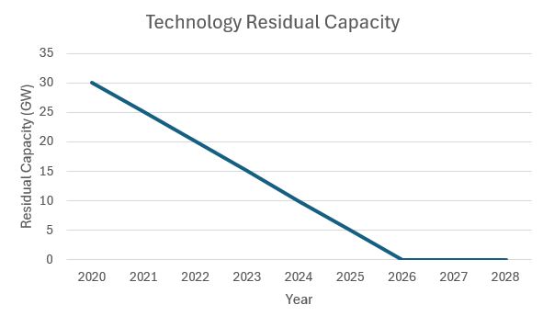
14.3 Basics in Model Calibration
14.3.2 Residual capacity - Example
Historical
Projected
In the example below you have a capacity of 30 GW in the base year (2020) for a technology with a 5-year operational life and project residual capacity from 2020 onwards using a linear decline.
12
Notes:
The example above shows how you would calculate the residual capacity for future years by linearly decreasing the residual capacity in the base year (which is 2020 in this case) based on the operational life of the technology (which is 5 years in this example).

Slide 13
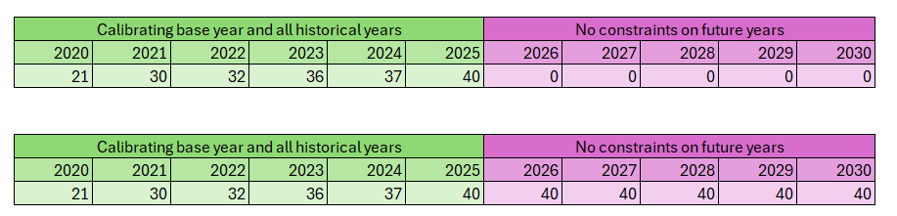
14.3 Basics in Model Calibration
14.3.3 Total Technology Annual Activity Lower Limit
Total minimum level of activity allowed for a technology in one year.
1)
2)
13
Notes:
As mentioned before, calibration can be achieved through the Total Technology Annual Activity Lower Limit parameter. This parameter ensures that a technology produces at least a specified minimum amount of energy in a given year. For instance, if the biomass stove technology has a lower limit set to 20 PJ in 2023, the model will generate an activity where biomass stoves produce at least 20 PJ of cooking service in that year. While the technology may produce more than 20 PJ, the parameter guarantees a minimum production level without restricting maximum output. Typically, we use the ‘Total Technology Annual Activity Lower Limit’ parameter to calibrate only the base year using something like the energy balance, however, there are two common times this parameter is additionally used for calibration, this is:
To calibrate all historical years
To force technology use throughout the timeline
For calibrating all historical years:
If you get the economics right for your country, which is the eventual aim of any modelling exercise, you shouldn’t see abrupt early retirements of existing capacity. However, if there is no readily available data on economics for your country then there are situations where residual capacities can be entirely unused in the model because the model deems it more cost-effective to scrap existing capacity and invest in another technology. There can also be instances where a capacity is fully utilized in one year but abruptly becomes unused in the next year. These behaviours reflect the nature of OSeMOSYS as a cost optimization model. It aims to determine the least-cost solution for energy production and usage while neglecting certain practical realities of energy systems such as assuming a country would completely scrap existing capacity within one year. To avoid such unrealistic outcomes, we may need to calibrate energy production for each sector for historic years to match reality and build confidence in the model. Historical production data, such as electricity, heat, or other energy services, can be sourced from final energy balances or sector-specific reports for all historic years and not just the base year. Then the lower (and often upper limits) can be used to calibrate the historical years to ensure it matches reality. In example 1 of the slide above, only the historical years have been calibrated, and then future years are not.
For calibrating future years:
For certain technologies you may have to force activity throughout the timeline because technology use in the real-world is not based on economics but other factors such as convenience. This means the model wouldn’t choose to invest in this technology since it isn’t one of the most cost-effective options, but we know it will still be used due to societal behaviour. For example, resistive heaters are not the cheapest form of heating, but they are used in various places for numerous reasons such as a lack of heating infrastructure. It therefore makes sense to force a flat use of this technology throughout the modelling period, this can be seen in the slide Example 2 above.

Slide 14
14.3 Basics in Model Calibration
14.3.4 Total Annual Max Capacity Investment
Maximum new capacity allowed for a technology in one year.
The default value is 999,999, which represents no constraint on the new installed capacity for a technology.
By setting this parameter to zero during the calibration years, we deactivate technologies that are not part of the energy mix in the historical data.
Example of how to parametrize a current technology in the mix (coal power plant) and a potential technology for the future (geothermal power plant)
Technology | Calibration years (known data) |  |  |  | Optimized modelling period
 | 2021 | 2022 | 2023 | 2024 | 2025 | 2026 | 2027 | 2028 | 2029
Coal power plant | 999999 | 999999 | 999999 | 999999 | 999999 | 999999 | 999999 | 999999 | 999999
Geothermal power plant | 0 | 0 | 0 | 0 | 999999 | 999999 | 999999 | 999999 | 999999
14
Notes:
During the calibration years, we add all existing capacities and energy productions to replicate the expected historical behavior. At the same time, we ensure that technologies not included in the energy mix during those years are not installed.
To achieve this, we can use the parameter Total Annual Max Capacity Investment, which sets the maximum new capacity that can be installed for a technology per year. For example, if this parameter is set to 1 GW, the maximum new capacity installed in that year cannot exceed 1 GW. Setting the parameter to zero effectively deactivates any new capacity for that technology.
By setting Total Annual Max Capacity Investment to zero during the calibration years for all technologies that weren’t used in the historical years, we ensure the energy mix aligns with historical data. However, it’s crucial to restrict this parameter to the calibration years only; otherwise, these technologies will be unable to compete in future scenarios. It could also be advisable to set this parameter to zero for a few years beyond the last calibration year for technologies with long construction periods. For example, it is unlikely that an energy planner would propose a hydropower plant to be installed between 2024 and 2025, given that such plants typically require 5 to 10 years to build.

Slide 15
Lecture 14.3 References
KTH. (2018). OSeMOSYS Documentation. https://osemosys.readthedocs.io/en/latest/index.html#
Plazas-Niño, F. (2024). Step-by-Step Guide to National Energy System Modelling with OSeMOSYS (v1.0). Zenodo. https://doi.org/10.5281/zenodo.13883416
15

Slide 16
14.4 Quality assurance
14.4.1 What is an energy scenario?
Energy scenarios describe current and possible representations or developments of the energy system in terms of technical and organizational options (Grundwal et al., 2016)
In the case of OSeMOSYS, without imposed constraints, each run represents a baseline scenario of least-cost development of the system.
Notes:
Energy scenarios are possible representations used to explore potential futures for energy systems. They provide representations of how technical, organizational, and policy decisions could shape the energy landscape over time. Scenarios help policymakers, researchers, and industry stakeholders understand the consequences of different decisions, such as remaining the same, choosing the most cost-effective options, adopting new technologies or implementing specific policies. As Grundwald et al. (2016) explain, scenarios are not predictions but structured explorations of possible pathways, making them crucial for strategic planning in energy transitions.
In the context of OSeMOSYS, an energy scenario is a run of how a least-cost energy system could evolve under specific conditions. Without additional constraints, OSeMOSYS optimizes the system to minimize costs, providing a "baseline" scenario of the most cost-efficient development. However, by imposing constraints—such as emissions targets, technology limits, or policy objectives—you can create alternative scenarios to study how different decisions impact costs, technology choices, and environmental outcomes. This flexibility makes OSeMOSYS a powerful tool for exploring diverse energy futures.

Slide 17
14.4 Quality assurance
14.4.2 Using Constraints in Scenarios
 | Name | Description
Activity constraints | Total Technology Annual Activity Upper Limit | Total maximum level of activity allowed for a technology in one year.
 | Total Technology Annual Activity Lower Limit | Total minimum level of activity allowed for a technology in one year.
Capacity constraints | Total Annual Max Capacity | Total maximum existing (residual plus cumulatively installed) capacity allowed for a technology in a specified year.
 | Total Annual Min Capacity | Total minimum existing (residual plus cumulatively installed) capacity allowed for a technology in a specified year.
 | Total Annual Max Capacity Investment | Maximum capacity of a technology, expressed in power units.
 | Total Annual Min Capacity Investment | Minimum capacity of a technology, expressed in power units.
Emissions | Emissions Penalty (i.e., carbon price) | Penalty per unit of emission.
 | Annual Emission Limit | Annual upper limit for a specific emission generated in the whole modelled region.
Notes:
In OSeMOSYS we often use constraints to help us reflect reality, policies, and develop scenarios. Some of these constraints were already touched on in previous lectures but you can see them defined again in the slide above.
Let’s start with some examples of using constraints. For example, if the model doesn’t have country-specific techno-economic data perhaps you want to match the historical years model behaviour to reality by forcing the activity using ‘Total Technology Annual Activity Upper Limit’ and ‘Total Technology Annual Activity Lower Limit’ constraints as mentioned previously. Another example could be that you want to represent a country’s NDCs which might say that they want to invest in 10 GW of solar by 2030. To do this you could apply an investment constraints using Total Annual Min Capacity to reflect the annual investment in solar required to meet the 2030 target.
Another example could be that a country has a Net Zero emissions target by 2053, then you could apply an annual emissions limit to get to net zero by 2053.
Consequently, constraints can be used for two main things: 1. To validate a scenario (least-cost scenario i.e. a scenario with little to no constraints other than those reflecting reality or calibration) 2. To build scenarios

Slide 18
14.4 Quality assurance
14.4.3 Introduction to Scenario Validation
Validation doesn't mean we can perfectly predict the future—but it ensures our model behaves reasonably and that scenarios are grounded in reality. This is essential before using the results to inform policy or investment.
There are many different types of validation, some examples include:
Compare model outputs to historical data (e.g. Energy mix, emissions, costs)
Check whether the least-cost scenario follows known trends
Implement constraints throughout the time frame to ensure the model is realistic for that country
Notes:
This slide introduces the concept of scenario validation in OSeMOSYS, emphasizing that while models can't predict the future, validation ensures scenarios are credible and grounded in reality. Validation helps confirm that the model behaves as expected and supports trustworthy decision-making.
Validation can involve:
Comparing outputs to historical data – this is typically for the base year but can also be for all historic years if you do not have country-specific techno-economics.
Checking whether low-cost pathways reflect known trends – ensuring the model is investing and using technologies that we know are the cheapest for the sector based on the input data we entered into the model. If an expensive or unexpected technology is appearing this may indicate an issue with the data entered or the way the model is set up. Another important thing here is ensuring the model does not abruptly change to another technology. The model could do this if it is cheaper overall to simply switch to another fuel type. Although this could be cheaper it is unrealistic for a country to completely switch to a different technology than it has historically been using within a year or a few years. Therefore, the modeller must add constraints to make the switch smoother and over time.
Applying realistic constraints to ensure the scenario remains relevant for a specific country context – if you know a country has limited resources for a particular technology then it validates the model to reflect this using constraints. This list is not exhaustive.

Slide 19
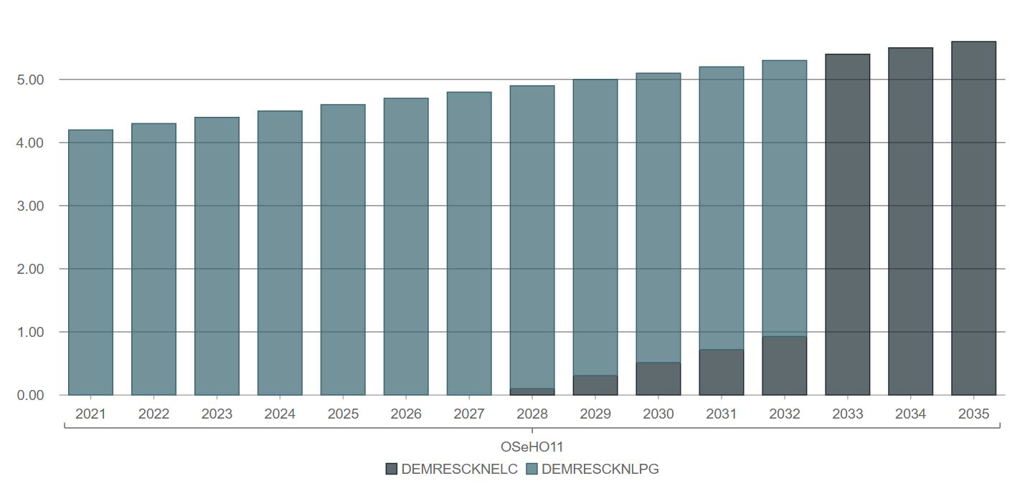
14.4 Quality assurance
14.4.4 Technology Penetration Rate
There are two methods to introduce a technology penetration rate:
Total Annual Max Capacity Investment: This parameter limits the maximum new capacity that can be installed each year.
Technology Activity Increase By Mode Limit: This parameter limits the maximum percentage increase in activity that a technology can achieve each year.
A penetration rate helps prevent abrupt jumps in technology utilization.
19
Notes:
Another common behavior observed in optimization results is the sudden jump in installed capacities from one year to the next when a technology becomes significantly cheaper than another in supplying an energy service. In reality, it is nearly impossible to decommission all installed capacity of one technology in a single year to make way for a new one.
To address this, we can incorporate a technology penetration rate using two approaches:
Total Annual Max Capacity Investment: This parameter sets a limit on the maximum new capacity that can be installed each year, based on historical data and market projections. For instance, if the power mix has been growing at an average rate of 1.2 GW per year, this value or a percentage of it could be used to regulate the penetration of new technologies in future years.
Technology Activity Increase By Mode Limit: This parameter limits the annual growth in activity levels for a technology to a specified percentage. For example, if a power plant generates 20 PJ in 2023 and the parameter is set to 0.1 (10%), the maximum generation in 2024 would be capped at 22 PJ (10% of 20 is 2, so 20 + 2 = 22). The percentage increase can be derived from historical trends or sectoral reports.
By applying these parameters, we can create a more realistic representation of technology transitions in energy systems.

Slide 20




14. Quality assurance
14.4.5 Total Technology Model Period Activity Upper Limit
Total maximum level of activity allowed for a technology in the entire modelled period. It represents the total reserves of fossil fuels.
Crude oil
Natural gas
Coal
Nuclear fuels
Notes:
Energy systems cannot produce energy infinitely. For fossil fuels, it is crucial to specify the reserves available for each type of fuel, including crude oil, natural gas, coal, and nuclear fuels. These reserve data are typically reported in weight or volume terms and must be converted into energy units. For example, 1 million barrels of oil is approximately 6 PJ.
To represent this in the model, we use the parameter Total Technology Annual Activity Upper Limit. This parameter sets a maximum limit on energy production for the entire modelling period.

Slide 21
14.4 Quality assurance
14.4.6 Total Technology Annual Activity Upper Limit
Total maximum level of activity allowed for a technology in one year. It represents the technical potential of energy production of a technology.
Fossil fuels
Renewables
Controlled by depletion features in each reservoir or mine.
Controlled by natural conditions of each region
This parameter is defined for primary energy technologies such as MINCOA or MINBIO.
Notes:
For fossil fuels, annual energy production cannot increase disproportionately from one year to the next. Oil reservoirs and coal mines have maximum production levels dictated by their depletion characteristics. However, detailed data on these limits is often unavailable, making it difficult to calculate an accurate average for an aggregated technology representing fuel extraction.
A simple approach is to use historical production data, taking the highest value as the default for the early years of the modeling period. This maximum can then increase linearly by a reasonable percentage over time. Adjustments can also be made if there is data on the development of new reservoirs or mines expected to become commercially viable in the future.
For renewables, the annual maximum potential is determined by the region or country’s natural conditions. For example, wind speed directly impacts the energy generated by wind power plants, typically referred to as the technical potential of the energy source.
In both cases—fossil fuels and renewables—the maximum annual energy production is defined using the Total Technology Annual Activity Upper Limit parameter. We add this parameter for primary energy source technologies (e.g., MINNGS, MINCOA, MINSOL, MINHYD)

Slide 22




14.4 Quality assurance
14.4.7 Total Annual Max Capacity
Total maximum (residual plus cumulatively new installed) capacity allowed for a technology in a specified year. Specially used for renewable power plant technologies.
Solar
Wind
Hydro
Geothermal
This parameter is defined for power plant technologies such as PWRSOL or PWRWND.
Notes:
For renewable energy sources, the technical potential may sometimes be expressed in capacity units (GW) rather than energy production (PJ). For example, reports may estimate a maximum installed capacity of 30 GW for photovoltaic solar power plants. This upper limit on total possible installed capacity can be used instead of the maximum energy production discussed on the previous slide.
In such cases, the parameter Total Annual Max Capacity is used. This parameter sets a maximum limit on the total installed capacity, including both residual (pre-existing) capacity and new cumulative capacity.
It is important to note that this parameter is applied to power plant technologies, not primary energy sources.

Slide 23

14.4 Quality assurance
14.4.8 Total Annual Min Capacity Investment
Minimum new capacity of a technology to be installed, expressed in power units.
We can use this parameter to account for all future energy projects confirmed to come online within the modeling horizon.
For example, a new solar plant with a capacity of 0.2 GW planned to be in operation in 2025.
23
Notes:
In some cases, significant projects such as power plants or industrial facilities are under construction and expected to come online within the next few years. When detailed information about these projects—such as capacity, technology type, and start year—is available, we can integrate this data into the model.
To account for these capacities, we use the parameter ‘Total Annual Min Capacity Investment.’ For each technology and the corresponding year, the value of the New Planned Installed Capacity is specified. For instance, if a solar PV power plant with a capacity of 0.2 GW is under construction and scheduled to become operational in 2025, we would input a value of 0.2 for the year 2025 under the technology code PWRSOL. This approach can be applied to any type of technology. However, it’s important to ensure that the capacity being included is significant and its operation is confirmed.
For newly planned capacities, it is also possible to set an expected level of production based on the installed capacity. Since this is a fixed new capacity, its potential energy production can often be assumed to remain constant throughout its operational life.
For example, a new natural gas power plant with a capacity of 0.1 GW planned for 2025 could generate approximately 2.5 PJ per year. If the plant has an operational life of 25 years, we could set the parameter ‘Total Technology Annual Activity Lower Limit’ to 2.5 PJ for each year from 2025 to 2049.
If there is no requirement to define a minimum production level for the new facility, this step can be omitted. By leaving the production unconstrained, the model can determine whether the plant becomes a stranded asset—unused capacity in the optimized system.
When adding data for Total Annual Min Capacity Investment, it is essential to ensure that the values are equal to or below the Total Annual Max Capacity Investment. Setting a minimum level higher than the maximum will result in an infeasible solution.

Slide 24
Lecture 14.4 References
KTH. (2018). OSeMOSYS Documentation. https://osemosys.readthedocs.io/en/latest/index.html#
Plazas-Niño, F. (2024). Step-by-Step Guide to National Energy System Modelling with OSeMOSYS (v1.0). Zenodo. https://doi.org/10.5281/zenodo.13883416
24

Slide 25
Thank you
Consolidated by:
Fernando Plazas-Niño, Leigh Martindale
www.climatecompatiblegrowth.com

